Slide 1

k.s. school of business management and information technology
Smit Agola Faculty Name: Moinuddin Quraishi
Jay Prajapati
Meet Panchal
Notes:
NOTE:
To change the image on this slide, select the picture and delete it. Then click the Pictures icon in the placeholder to insert your own image.

Slide 2
topics
Copyright Act 1957
Integrated Circuit Designing
Geographical Indication

Slide 3
Copyright act 1957

Slide 4
What is Copyright ?
Copyright is a bundle of exclusive rights granted by law to the creators of literary, dramatic, musical and artistic works and the producers of cinematography films, sound recordings and computer software to do or authorize the doing of certain acts with regard to their creation.
It is a kind of protection against unauthorized use of a work.

Slide 5
Copyright In Expression
An idea is not protected by Copyright, only the expression of the idea is copyrighted. When the idea can be expressed in only one way, then it is called copyright violatation.

Slide 6
Copyright Act 1957
Copyright act lists the various areas of expressions, for example, art, literature, music and film, which can be copyrighted.
The Act prohibits the copying or reproduction of copyrighted material.
If any person use copyright material without inform it’s copyright holder than he/she can prosecute a person making unauthorized use and can claim damage and compensation.

Slide 7
Continue
The Copyright Act , 1957 came into effect from January 1958.
The act has been amended five times since it was introducing.
The act was amended in 1995 , as a part of the commitment under the GATT, to include ‘Computer programmes, tables and compilations including databases’ in the definition of literary work.

Slide 8
Rights of Copyright Owners
Rights in Literary, Dramatic and Musical Work
Rights in Computer Programme
Rights in Artistic Work
Rights in Cinematographic Film
Rights in Sound Recording

Slide 9
Ownership of Copyright
Author of a work is the first owner . Author means
Author of literary or dramatic work.
Composer of music work.
Artist of artistic work
Producer of cinematographic film or sound recording
Right of author is subject to some limitations.

Slide 10
Assignment of Copyright
The owner of the copyright can assign the copyright to a work. Such assignment can be partial or full or subject to limitations and for limited term or full term. Even rights of future work can be assigned, but the assignment becomes effective only when the work comes into existence.

Slide 11
Term of Copyright
The term of literary, dramastic, musical or artistic work is when published during lifetime of the author and it subsits for the next sixty years from the death of the author.
The literary, dramastic, musical or artistic work which is anonymous or pseudonymous, term of it’s copyright is for next sixty years from the date of publication.

Slide 12
Compulsory Licensing
If owner does not grant permission for re-publications, performance or communication to public.
Copyright Board can direct Registrar of Copyrights to grant compulsory licence to complainant on such terms and conditions as is deemed fit.

Slide 13
Registration of Copyright is Optional
Copyright may be registered with the Registrar of Copyrights, But registration is not Compulsory.
The register will contain details like name or title or work, names and addressees of authors, publishers and owners of copyrights.

Slide 14
Civil and Criminal Remedies under Copyright Act
Section 63 of the Copyright Act , 1957 provides that an offence of infrigment of copyright or other rights conferred by the Act shall be punishable with imprisonment for a term which shall not be less than 6 months but may extends to 3 years with the fine which shall not be less than 50,000 rupees but which may extend to 2,00,000 rupees.

Slide 15
Continue
Section 63A provides for enhaced penalty on second or subsequent convictions i.e., imprisonment for a term which shall not be less than one year but which may extend to 3 years and with fine which shall not be less than 1,00,000 rupees and which may extend up to 2,00,000 rupees.

Slide 16
Continue
Section 63B provides that any person who knowingly makes use on a computer an infringing copy of a computer program shall be punishable with imprisonment for a term which shall not be less than 7 days but which may extend to 3 years and with fine which shall not be less than 50,000 rupees but which may extend to 2,00,000 rupees.

Slide 17
Information Technology and Copyrights
Copyright of computer software is protected under the provisions of the Indian Copyright Act, 1957.
The Copyright (Ammendment) Act 1994, clearly explains the rights of the user to make backup copies and the heavy punishment and fines on infingment of copyright on software.

Slide 18
Exception to Copyright Infrigment
The moral justification for copyright is that a person should be able to reap the benefits of his or her cration or mechanical labour.
But a copyrighted work can be used without the consent of the copyright holder to facilitate education, research and the dissemination of knowledge and information for the promotion of the ecocomy and culture of a society.
The fair use doctrine is a valid defence when there is market failure, or when transfer of use to the defendant will benefit society, or when such fair use would not cause any substantial injury to the copyright owner.

Slide 19
Continue
Some situations when the exceptions to copyright infringement are invoked :
Factual material is open to public inspection.
Act was done for parliamentary / judicial proceedings.
Acts done in pursuance of ends specifically authorized by the Copyright Act, such as advancement of education, use in libraries and / or research, in the course of instruction, performance in classrooms, broadcast recorded for educational use, etc.
Protection of the public’s right to be informed through photographs, news shots, reporting of events.

Slide 20
Continue
e) Use for the purposes of criticism or review.
f) Public reading or recitation of literary work.
g) Recording of a work by a party that is entitled to broadcast it.
h) Showing of broadcast to public audience who have not paid for admission to venue.
Home taping of broadcast.

Slide 21
Continue
e) Use for the purposes of criticism or review.
f) Public reading or recitation of literary work.
g) Recording of a work by a party that is entitled to broadcast it.
h) Showing of broadcast to public audience who have not paid for admission to venue.
Home taping of broadcast.

Slide 22
Continue
j) Reproducing one’s own work or using parts of it.
k) Filming under broadcasting a sculpture / work of art that is publicity situation.
l) Reproduction of an article in an artistic effort.
m) Backup copies of computer software.
n) Copies made to advertise the product itself.

Slide 23
Harry Potter vs. Hari Puttar
“Hari Puttar” is film that hit indian cinema after an indian court rejected a Warner Bros. lawsuit claiming the name was too close to its Harry Potter series. The court said in its ruling that people was know the difference between that and an Indian Punjabi film called “Harri Puttar – A comedy of Terros.” according to the producer – Mirchi Movies the puttar movie bore no resemblance to the famous boy wizard franchiese. Hari is a common name an India and Hindi for God, while “puttar” in Punjabi for son.

Slide 24
FAIR USE Docrine
One of the rights of the owner of copyrights is the right to reproduce or to authorize others to reproduce the literary or dramastic work in copies. This right is subject to certain limitatopms found in Copyrights Act.
One of the more important limitations is the doctratine of ‘Fair use’.

Slide 25
Continue
The following factors need to be considered that use of any particular copyright material is fair or not :
Purpose and character of the use
Nature of the copyrighted work.
Amount of work use in relation to the copyrighted work as a whole
Effect of the use upon the potential market for, or value of the copyrighted work.

Slide 26
A selfie by monkey – whose Copyrights ?
A selfie taken by a black macaque on the indinesian island of Sulawesi has become a copyrights war between Wikipedia and the photographer, who has climed that he is the owner of the selfie. Wikipedia has refused to remove the famous selfie saying the monkey and not the photographer owns the copyright because the animal took it. In this case neither photographer nor monkey used the creativity power of mind. Clicking photo was accidental episode and therefore neither can claim on copyrights.

Slide 27
Integrated circuit designing

Slide 28
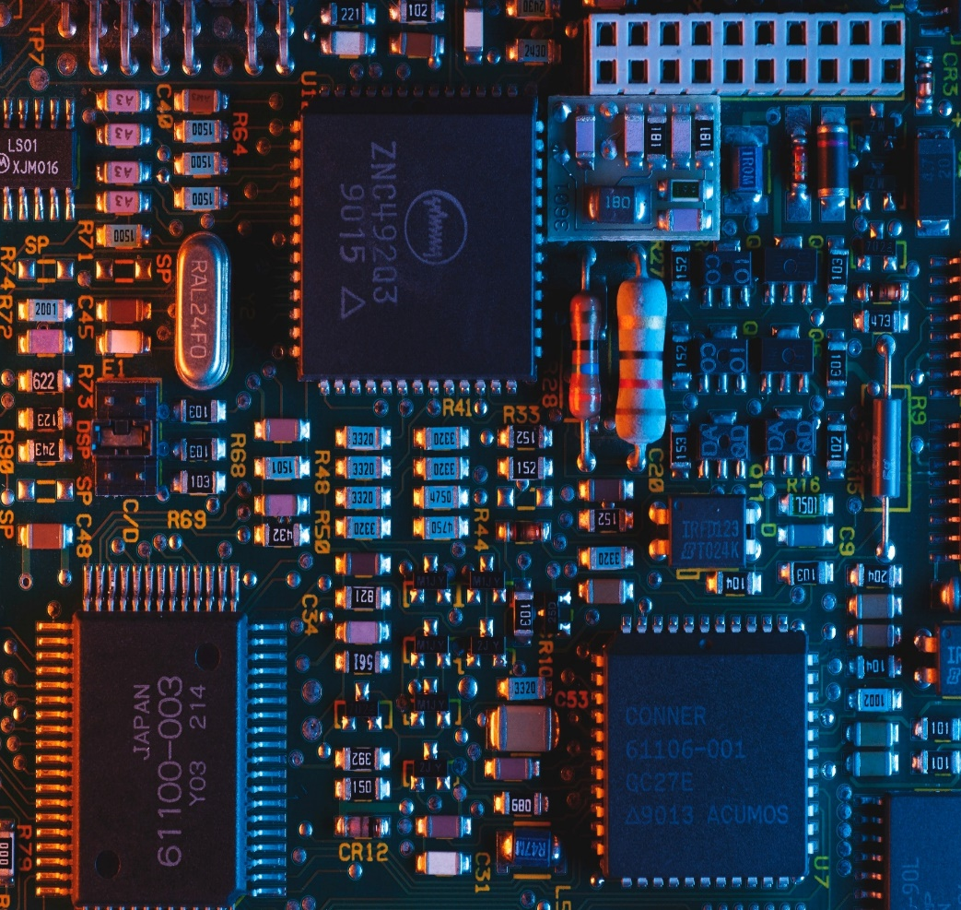
What is Circuit?
An integrated circuit or an IC is a semiconductor chip on which electric circuits are mounted.
An integrated circuit is created using certain logic methods and circuit layouts.
Sometimes called as a chip or microchip.
Modern Computers are using Very Large Scale Integration(VLSI) where numerous transistors are accommodated on a single chip.

Slide 29
Integrated Circuit Designing
Indian govt. has passed an Act to protect layout-designs of semiconductor integrated circuits.
The objective of the law is to promote the progress of innovation in integrated circuits.
The layout of designs of integrated circuits may not be protected under the patent so,regsistration became compulsory.

Slide 30
Infringement
If he/she use any of the rights of the owner of the layout design without permission. They will punishable as below.
Opposition to registration:- Section 11 of the Act.
Semiconductor Integrated Circuits Layout:- Design Act 2000,Section 15.
Application for registration:- Design Act 2000,Section 8.

Slide 31
Requirements
A layout design has following requirements to be eligible for registration:
Original:- A layout design should be independently created and not generally known.
Not commercialized:- A layout design should not have been commercialized in India or any country before the date of application for registration.

Slide 32
Continue
(3)Distinctive :-It means the design should be different from existing designs in order to be eligible for regsitration.

Slide 33
Rights
Right to use.
Right to distribute.
Right to sell.
Right to reproduce.
Right to import the layout design.

Slide 34
Summary
Integrated circuits called “Chips”,which are core components of Information Technology (IT).
To protect the circuit layout design, India has enacted TRIPS compliant Semiconductor Circuit Layout Design Act in 2000.
The tenure of the legal protection to registered design is 10 years.
The infringers are penalised with punishments and penalties.

Slide 35
Geographical indication

Slide 36
patents
Industrial
Property
Industrial
Designs
Intellectual Property
Treadmarks
Copyrights
Geographical
Indication

Slide 37
Introduction of GIS
Geographical indicators are the indication which identify a goods as originating in the territory of a member , or region or locality in that territory where a given quality, reputation or other chacterstics of the goods is essentially attributable to its geographical origin.
Geographical indicator is the newest addition to intellectual property right(IPRs) under section of part 2 of the TRIPS agreement and have been in article 22.1.

Slide 38
Introduction of GIS
Where a given quality , reputation or other characteristics of such goods is essentially attributable to its geographical origin
Refers to the geographical origin of products.
Not special characteristic implied.
The term ‘geographical indication’ is defined under Section 2(1)(e) of geographical Indication act.
Example :- Perfumes of paris , Basmati Chawal , Kasmir Apple.

Slide 39

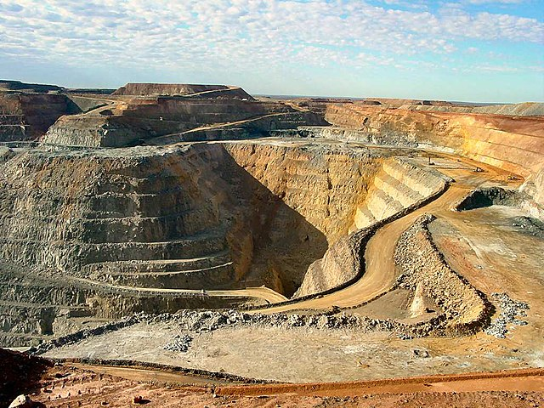
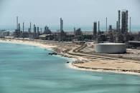
NATURAL GOODS
Lignite-neyvelli
GOLD-kolar ,s.africa
PETROLEUM-Arabian

Slide 40
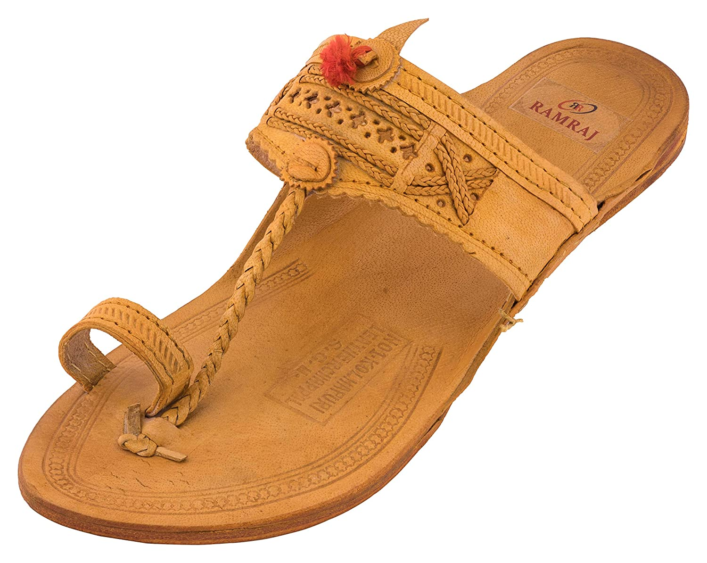
APPELLATION OF ORIGIN
Used on product have specified product quality that is exclusively due to the geographical environment in which the products are made.
Ex: kolhapuri chappal

Slide 41
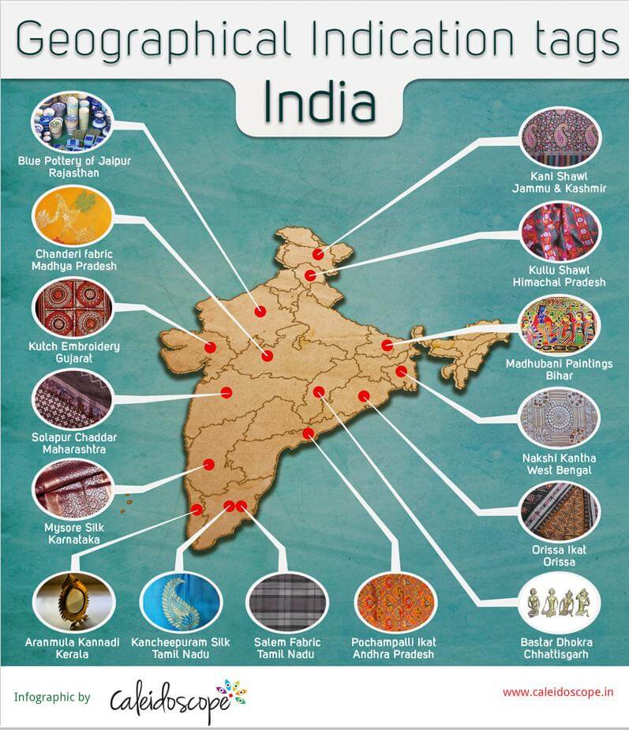
FEATURES OF GIS
Goods are protects that are already famous-reputation are pre exist.
It is functions like trademark.

Slide 42
Treadmarks vs. geographical indication
Treadmark
Geographical indication
It’s belongs to enterprise after a registration
Enterprise owns the rights
Right of usage is transferable.
It has fancy name.
Treadmark act,1999
It’s link to region or soil.
Nation owns the rights.
Right to use but owner ship is not transferable.
Name is associated with geographical area.
Geographical Indication Act,1999

Slide 43
PROTECTION OF GI INTERNATIONALLY
Paris Convention (1883)-False indication
Madrid Agreement(1891)-false and deceptive indication
Lisbon Agreement(1958)
TRIPS Agreement(1994)-Frist international treaty bound to protect Gis and enforce its application.

Slide 44
Who can apply for the registration of Geographical indication
Any association of persons , producers , organization under the law.
Registered proprietor.
Geographical Indications Registry with all-india jurisdiction ,At Chennai.

Slide 45

CASE STUDY :Darjeeling tea
Darjeeling Logo designed in 1983
Registration Under GI registry
Also sought protection in UK,US, japan , Ireland & other countries
Spent over 200000 USD in 1998-2002 for same.
Protected in 25 nations.

